Slide 1
Tree Detection
infrared.city-1
Moritz Hörmansdorfer Sara Klasová Dominik Oberhumer Nina Salnikow
2024

Slide 2
Agenda
Introduction
Project Outline
Data
Exploratory Data Analysis
Machine Learning Pipeline
Current Problems
Follow Up

Slide 3
Introduction

Slide 4
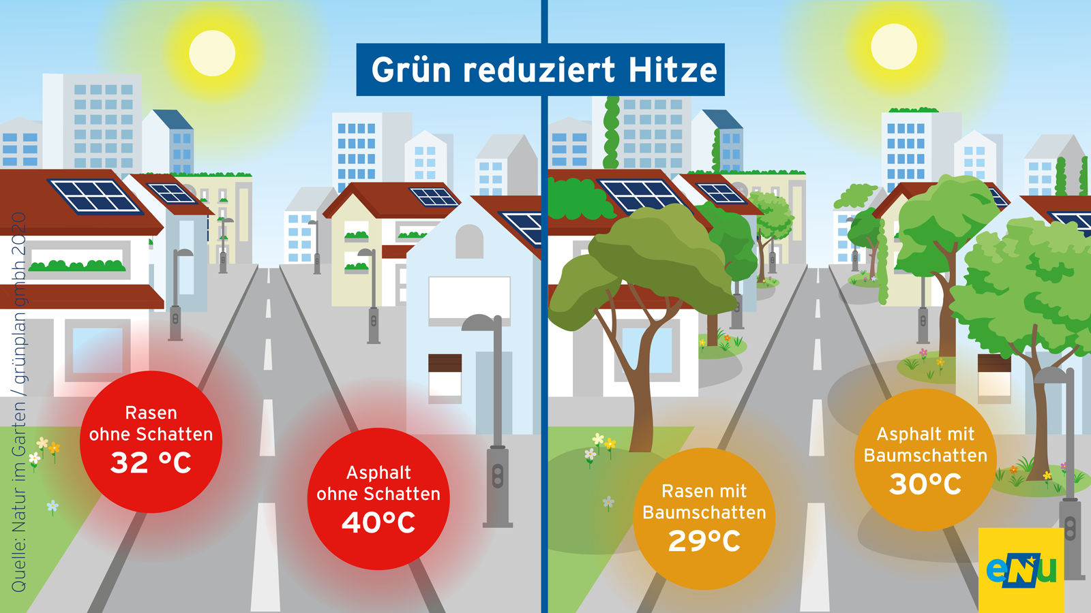
Introduction - Problem
Trees reduce urban heat
Notes:
Replaced AI generated image with real data from lower austria:
Green reduces heat picture
Asphalt without shade: 40 °C
Asphalt with tree shade: 30 °C
<hitze grafik> - wärmebild zB
Reden über klimawandel – es wird wärmer, hitze, gefahren
<bild grün, bäume>
Reden über kühlfaktor von bäumen
Bäume: Mikroklima
Bäume Hochwasserschutz

Slide 5

Introduction - Context
Infrared.city
Climate simulation platform
AI-powered
Simulates: thermal stress, wind comfort, etc.
Used by: architects, city government, etc.
Previous projects
Detected Flood Risk
Detected Greenspace
Notes:
<Logo Infrared> - kurz über den firmenpartner reden
<Vorjahresprojekte referenzieren>

Slide 6
Introduction – Project Outline
Input
Satellite Images
Open Street Map Land Use Layer
Tree register (“Baumkataster”)
Consider
Seasons (multiple)
Climate Zone (restricted -> middle european)
Output
Predicted Tree Locations
Notes:
Additonal talk
Out of scope:
Simulationen (Hitze, flut).
Kleine einzelbäume (die in auflösung unter gehen)

Slide 7
Data

Slide 8
Data Sources
Tree cadastre data
(Vienna, Paris, Barcelona, Hamburg)
Sentinel-2 data
OpenStreetMap data

Slide 9

Data Collection
~6GB dataset collected
Cleaned & standardized (e.g. rename columns)

Slide 10
What Worked / Improvement
Previous project: Manual image selection
Initial approach: Copernicus API
→ Switched to Google Earth Engine
Challenge: Cloud coverage filtering tuning

Slide 11
Exploratory Data Analysis

Slide 12
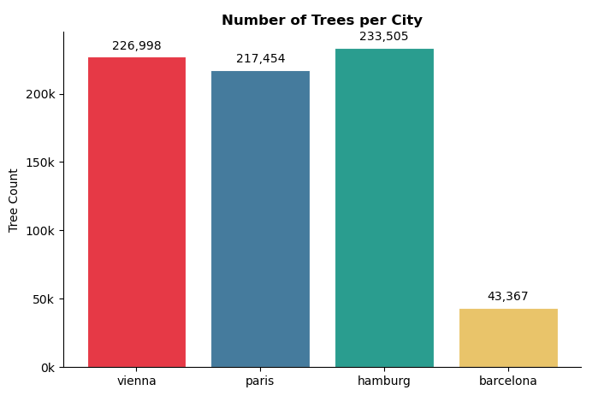
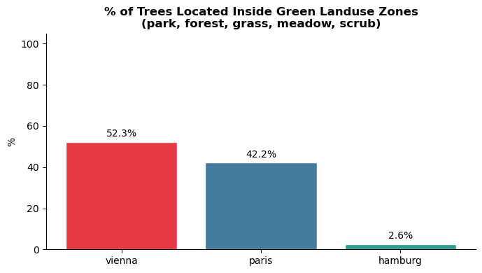
EDA
Vienna / Paris / Hamburg: ~220k–234k trees each — balanced training data
Barcelona: 43k trees, no geometry — generalization test only
Key finding: Hamburg trees are 97% street-planted vs. 52% park trees in Vienna — model needs to learn both patterns

Slide 13
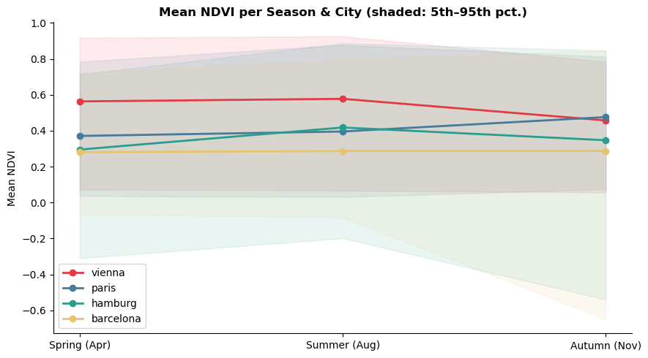
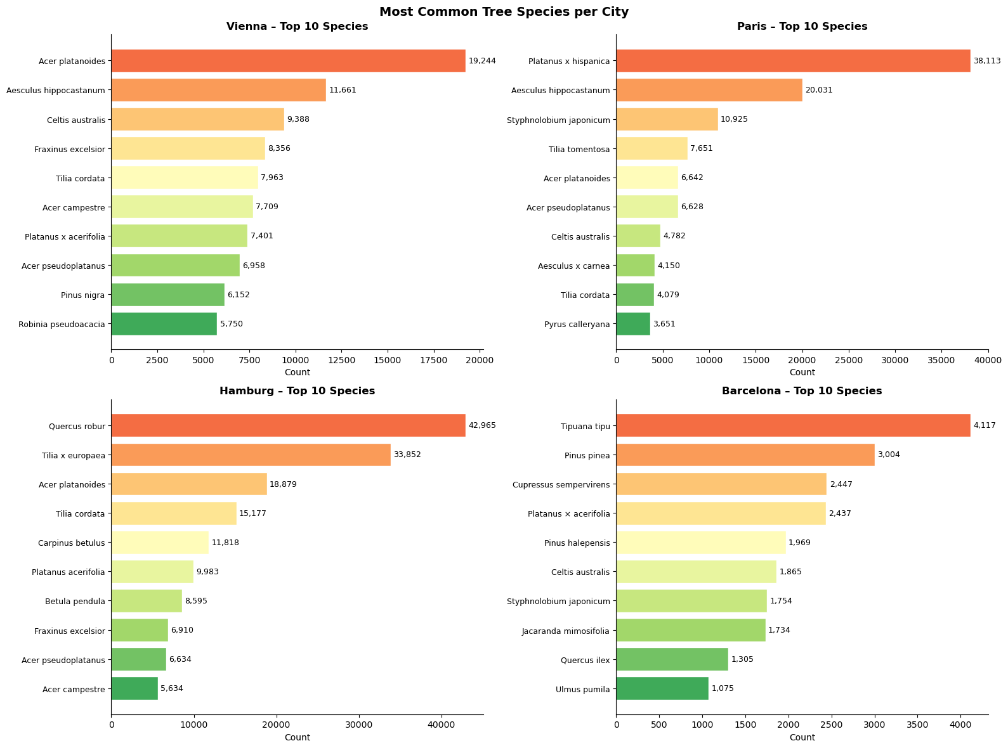
EDA
Summer (Aug) = strongest signal: Hamburg NDVI 0.42 vs. ~0.29 in spring/autumn
Seasonal contrast: summer vs. autumn NDVI drop distinguishes deciduous trees from grass/artificial surfaces
86 species shared across all cities —not used as model input, crown size expectations

Slide 14
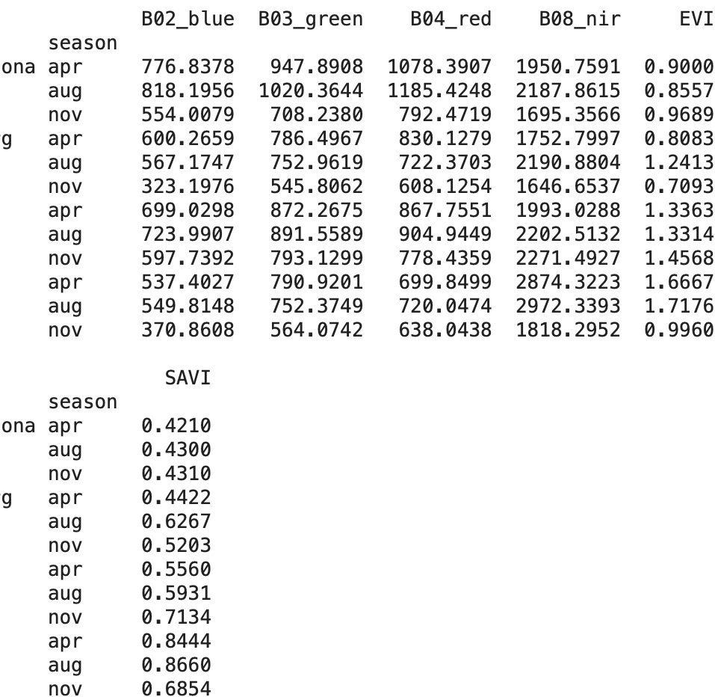
EDA - Challenges
EVI/SAVI scaling: values exceed 1.0 (false).
Cause: index formula applied to raw integers (0–10,000) instead of reflectance (0.0–1.0)
Fix: divide bands by 10,000 before recomputing — no rescraping needed, raw bands are in TIF stacks, NDVI is safe to use as-is
Vienna height column: stores category codes 1–8, not metres (mean 2.21 confirmed)
Fix: decode to midpoint values (e.g. code 2 → 8.0 m), will be applied in data cleaning step before training

Slide 15
Machine Learning Pipeline

Slide 16
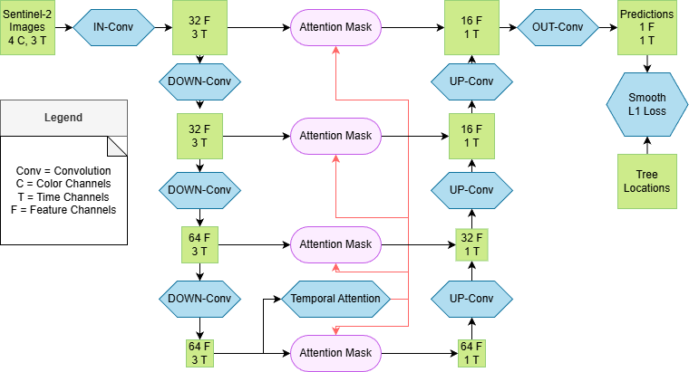
Model

Slide 17
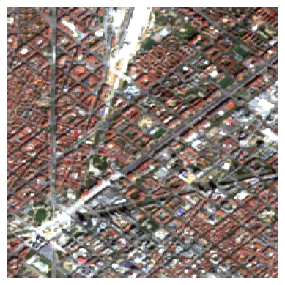
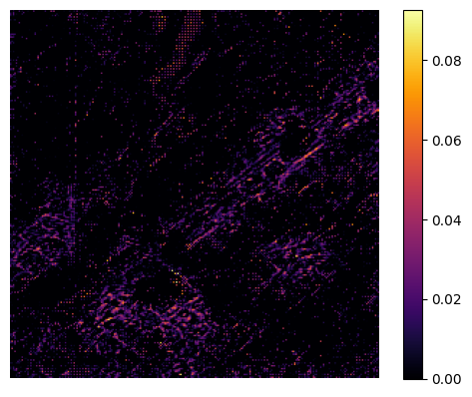
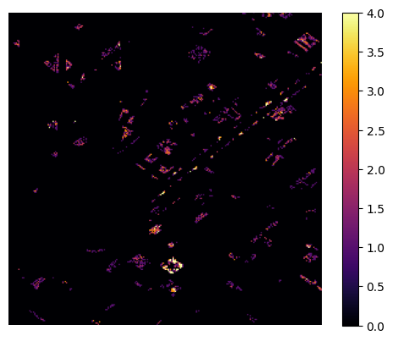
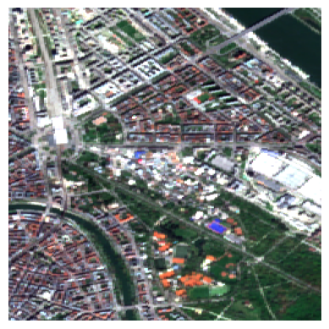
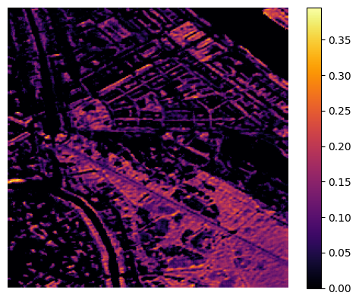
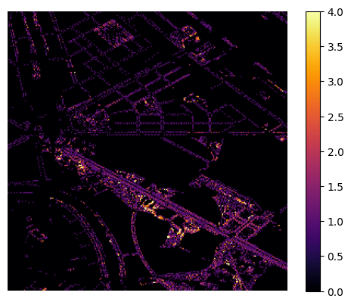
First results
Sentinel-2 Image
Model Prediction
Ground Truth
Barcelona
Vienna

Slide 18
Current Problems
Limited computational resources on WU Jupyter Hub
Sparse Coverage
Final database layout for Data Coaches

Slide 19
Follow Up
Inclusion of OSM data
Classification: predicting different structure types
Regression: predicting number of trees using different structure types
Train larger model for longer time
Pick best model to create tree cadastre database
Scrape new sentinel images to test model

Slide 20
Thanks for your attention

